Slide 1
Software Architecture & Design Lecture 06: Layered Architecture
Sarmistha Sarna Gomasta

Slide 2
Lesson Objectives
To understand the Layered Architecture
To know about application of Layered Architecture

Slide 3
Lesson Outcomes
At the end of this lesson student will
Get an idea of Layered architecture
Architect application using Layered Architectures

Slide 4
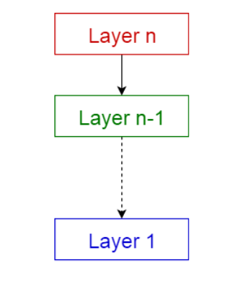
Layered/N-tier pattern
Layered architecture patterns are n-tiered patterns where the components are organized in horizontal layers.
This is the traditional method for designing most software and is meant to be self-independent. This means that all the components are interconnected but do not depend on each other.
Each layer provides services to the next higher layer.

Slide 5
Layered/N-tier pattern
The most commonly found 4 layers of a general information system are as follows.
Presentation layer (also known as UI layer)
Application layer (also known as service layer)
Business logic layer (also known as domain layer)
Data access layer (also known as persistence layer)

Slide 6
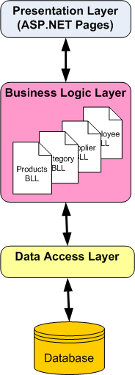
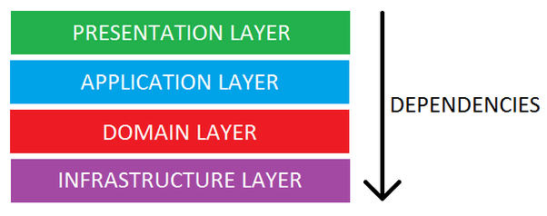
Layered/N-tier pattern

Slide 7
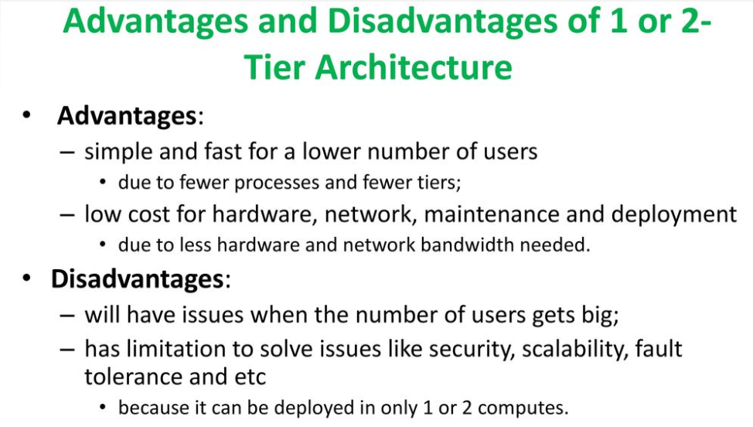

Slide 8
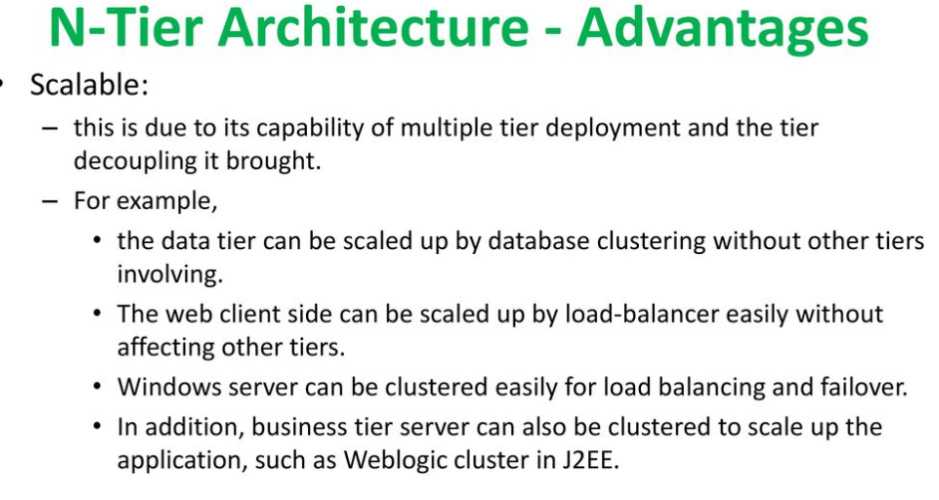

Slide 9
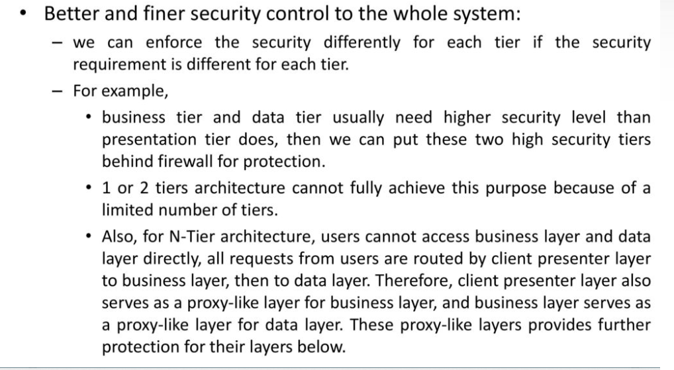

Slide 10
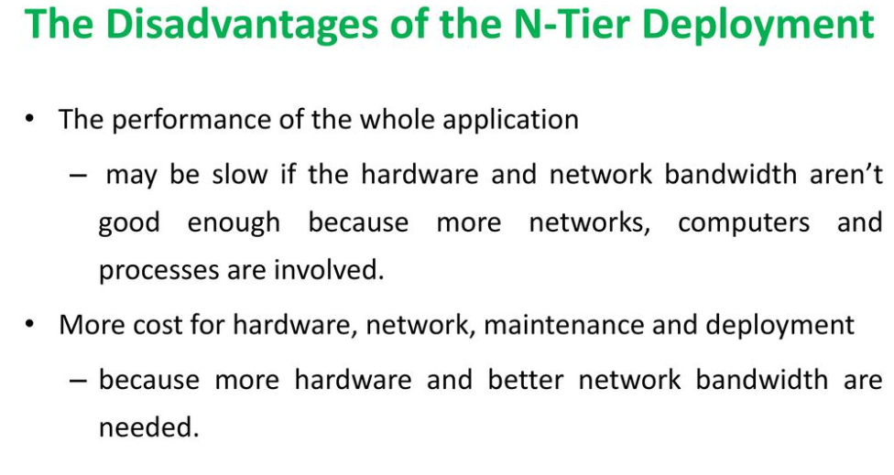

Slide 11
Layered/N-tier pattern- Usages
General desktop applications.
E commerce web applications.

Slide 12
Thanks

